Slide 1

Memory
Chris Piech
CS106A, Stanford University

Slide 2


Learning Goals
Be able to trace memory for objects
Be able to trace memory with instance variables

Slide 3
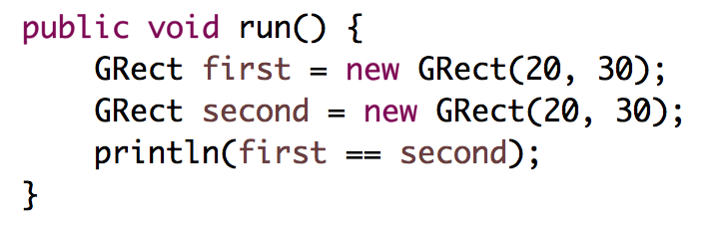
Who thinks this prints true?

Slide 4
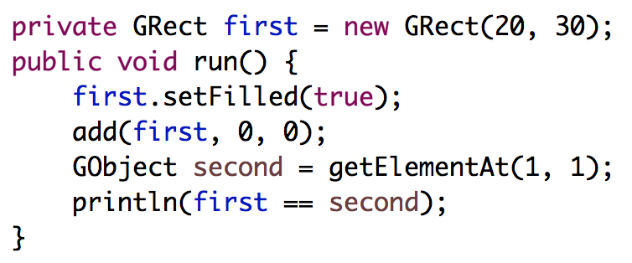
Who thinks this prints true?

Slide 5
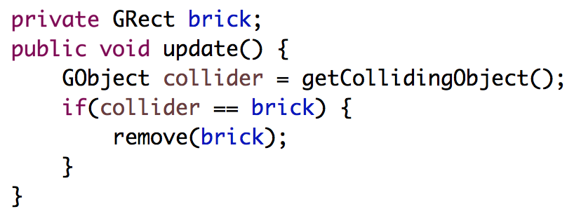
Deep Understanding is Key

Slide 6
[suspense]

Slide 7



Today’s Route
You are here
Friday
Instance
Variables
Canvas
The Heap
Core model
The River of Memories

Slide 8
Core memory model

Slide 9
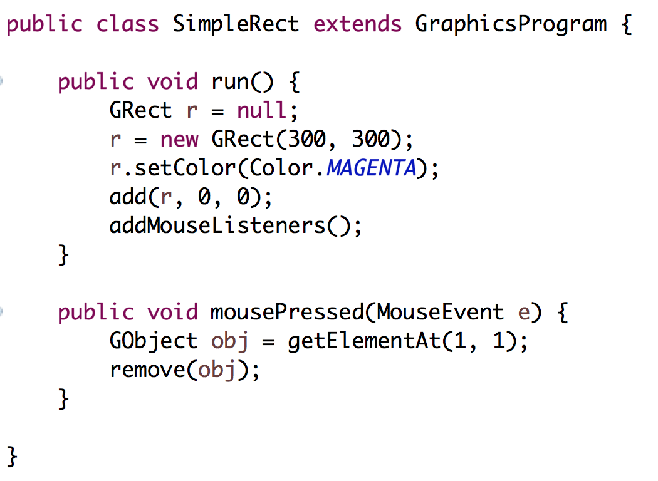
Stack Diagrams
public void run() {
println(toInches(5));
}
private int toInches(int feet){
int result = feet * 12;
return result;
}

Slide 10
Stack Diagrams
public void run() {
println(toInches(5));
}
private int toInches(int feet){
int result = feet * 12;
return result;
}
run

Slide 11
Stack Diagrams
public void run() {
println(toInches(5));
}
private int toInches(int feet){
int result = feet * 12;
return result;
}
run

Slide 12
Stack Diagrams
public void run() {
println(toInches(5));
}
private int toInches(int feet){
int result = feet * 12;
return result;
}
f
run
toInches
feet
5
result

Slide 13
Stack Diagrams
public void run() {
println(toInches(5));
}
private int toInches(int feet){
int result = feet * 12;
return result;
}
f
run
toInches
feet
5
result
60

Slide 14
Stack Diagrams
public void run() {
println(toInches(5));
}
private int toInches(int feet){
int result = feet * 12;
return result;
}
f
run
toInches
feet
5
stack
result
60

Slide 15
Stack Diagrams
public void run() {
println(toInches(5));
}
private int toInches(int feet){
int result = feet * 12;
return result;
}
f
run
60

Slide 16
Aside: Actual Memory

Slide 17
What is a bucket
feet
5

Slide 18
What is a bucket
feet
1011100111100011
0011010110010100
* Each bucket or “word” holds 64 bits

Slide 19
What does memory look like?
public void run() {
println(toInches(5));
}
private int toInches(int feet){
int result = feet * 12;
return result;
}

Slide 20
Stack Diagrams
run
toInches
inches
5
result
60

Slide 21
Actual Memory
run overhead
0011010011010001
1010110011010111
1111100000111100
0000111100001111
toInches overhead
feet
1011100111100011
0011010110010100
result
0101101110111101
1111011111101111
?
?

Slide 22
#0: don’t think on the binary level (yet)

Slide 23
Primitives vs Classes
Primitive Variable Types
Class Variable Types
int
double
char
boolean
GRect
GOval
Gline
Color
Class variables (aka objects)
Have upper camel case types
You can call methods on them
Are constructed using new
Are stored in a special way

Slide 24
Objects
GRect myRect = new GRect(20, 20);
Object

Slide 25
The Heap

Slide 26
public void run() {
GRect r = null;
}
stack

Slide 27
public void run() {
GRect r = null;
}
stack
run
r
null

Slide 28
Wahoo!

Slide 29
public void run() {
GRect r = new GRect(50, 50);
}
stack
heap
run
r

Slide 30
public void run() {
GRect r = new GRect(50, 50);
}
stack
heap
run
18
r

Slide 31
public void run() {
GRect r = new GRect(50, 50);
}
stack
heap
run
18
r
18

Slide 32
public void run() {
GRect r = new GRect(50, 50);
}
stack
heap
run
memory.com/18
r
memory.com/18

Slide 33
public void run() {
GRect r = new GRect(50, 50);
}
stack
heap
run
r

Slide 34
public void run() {
GRect r = new GRect(50, 50);
r.setColor(Color.BLUE);
r.setFilled(true);
}
stack
heap
run
r

Slide 35
public void run() {
GRect r = new GRect(50, 50);
r.setColor(Color.BLUE);
r.setFilled(true);
}
stack
heap
run
r

Slide 36
public void run() {
GRect r = new GRect(50, 50);
r.setColor(Color.BLUE);
r.setFilled(true);
}
stack
heap
run
r

Slide 37
#1: new allocates memory on the heap

Slide 38
#2: object variables store heap addresses
#ultimatekey

Slide 39
What does an object store?

Slide 40
An object stores a memory address!

Slide 41
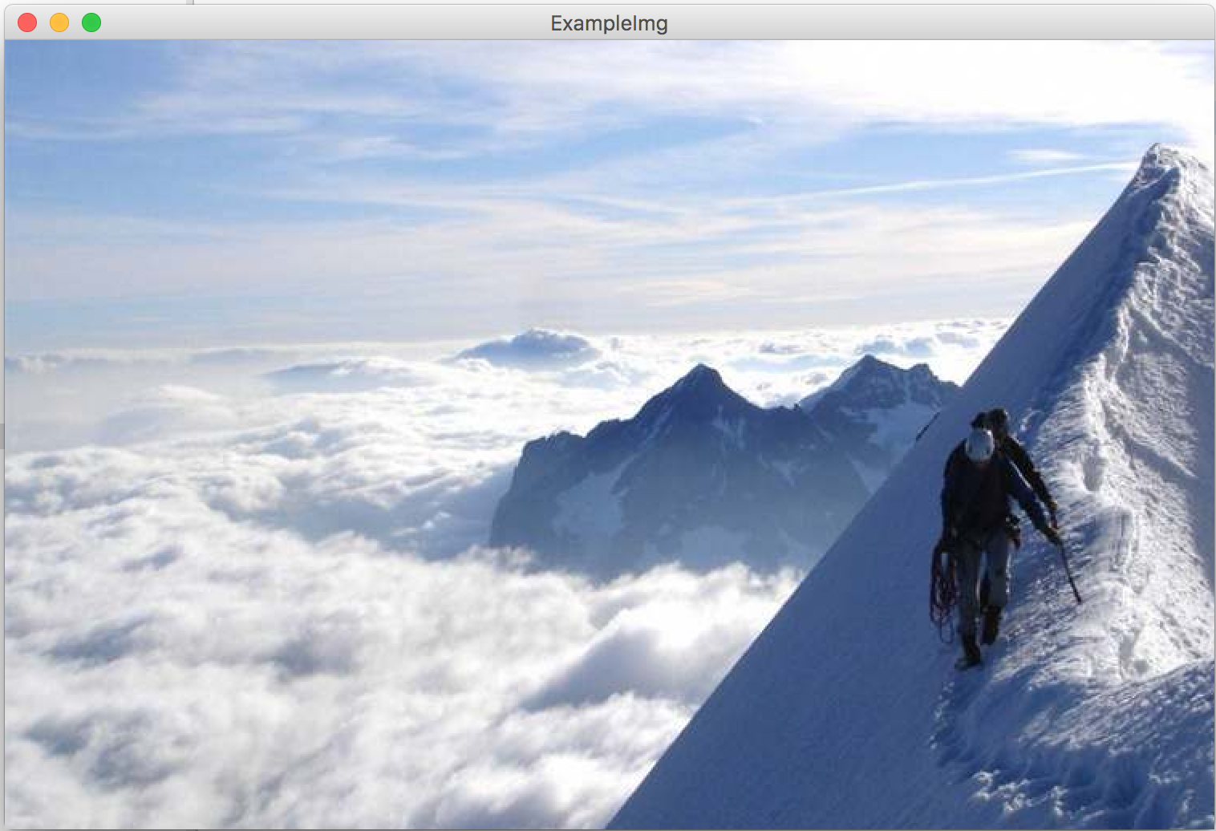
public void run() {
GImage img = new GImage(”mountain.jpg”);
add(img, 0, 0);
}
stack
heap
run
img

Slide 43
#3: GImages look impressive but don’t take much extra work

Slide 44
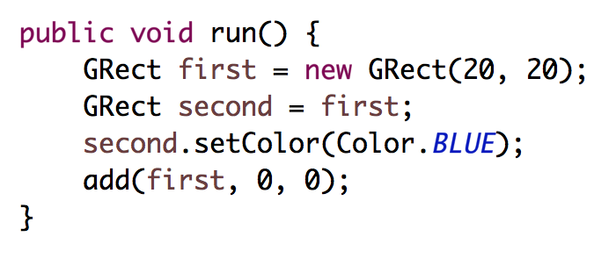
stack
heap
run
first
second

Slide 45
stack
heap
run
first
second

Slide 46
stack
heap
run
first
second

Slide 47
stack
heap
run
32
first
32
second

Slide 48
stack
heap
run
32
first
32
second
32

Slide 49
stack
heap
run
first
second

Slide 50
stack
heap
run
first
second

Slide 51
#4: when you use the = operator with objects, it copies the address

Slide 52
Passing by “Reference”

Slide 53
Primitives pass by value
// NOTE: This program is buggy!!
public void run() {
int x = 3;
addFive(x);
println("x = " + x);
}
private void addFive(int x) {
x += 5;
}
* This is probably the single more important example to understand in CS106A

Slide 54
Objects pass by reference
// NOTE: This program is awesome!!
public void run() {
GRect paddle = new GRect(50, 50);
makeBlue(paddle);
add(paddle, 0, 0);
}
private void makeBlue(GRect object) {
object.setColor(Color.BLUE);
object.setFilled(true);
}
* This is probably the single more important example to understand in CS106A

Slide 55
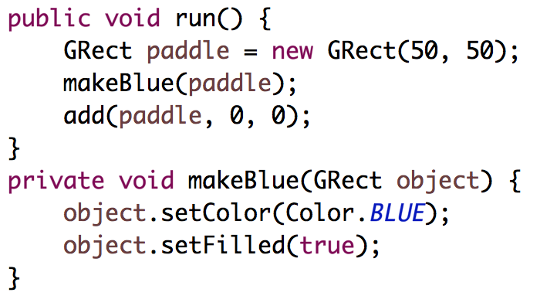

Slide 56
stack
heap
run
paddle

Slide 57
stack
heap
run
paddle

Slide 58
stack
heap
run
18
paddle
18
makeBlue
object

Slide 59
stack
heap
run
18
paddle
18
makeBlue
object
18

Slide 60
stack
heap
run
paddle
makeBlue
object

Slide 61
stack
heap
run
paddle
makeBlue
object

Slide 62
stack
heap
run
paddle
makeBlue
object

Slide 63
stack
heap
run
paddle

Slide 64
stack
heap
run
paddle

Slide 65
#5: when you pass (or return) an object, the address is passed.
Aka reference

Slide 66
What does an object store?

Slide 67
An object stores a memory address!

Slide 68
public void run() {
GRect r = new GRect(50, 50);
}
stack
heap
run
18
r
18

Slide 69
Canvas

Slide 71

Canvas
Heap
Instance Variables
12
canvas
12
run
r
12

Slide 73
Canvas
Heap
Instance Variables
12
canvas
94
mousePressed
e
94
x = 72
y = 94
time = 192332123
obj
12

Slide 74
Canvas
Heap
Instance Variables
12
canvas
94
mousePressed
e
94
x = 72
y = 94
time = 192332123
obj
12

Slide 75
#6: graphics programs all have a “canvas” which keeps track of the objects on the screen

Slide 76
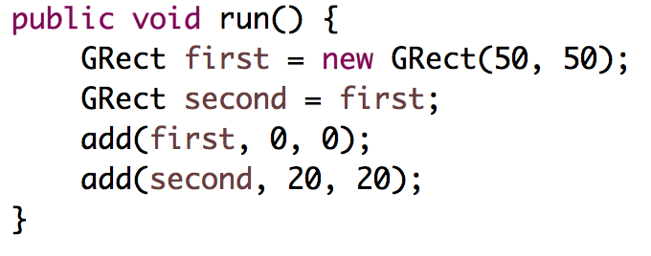
Intentionally left blank so that we can fill it in during lecture

Slide 77
What does an object store?

Slide 78
An object stores a memory address!

Slide 79
Instance Variables

Slide 80
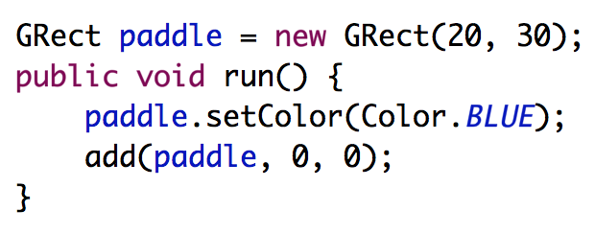
heap
Instance Variables
canvas
paddle

Slide 81
heap
Instance Variables
canvas
paddle

Slide 82
heap
Instance Variables
canvas
paddle
run

Slide 83
heap
Instance Variables
canvas
paddle
run

Slide 84
heap
Instance Variables
canvas
paddle
run

Slide 85
#7: there is space for all instance variables. They are accessible by the entire class

Slide 86
#8: instance variables are initialized before run is called

Slide 87
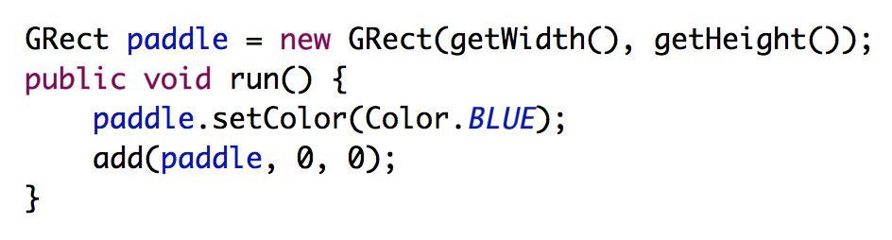
Common Bug
Question: what does this program do?
Answer: makes a square that is 0 by 0 since getWidth is called before the screen has been made.

Slide 88
Today’s Route
You are here
Friday
Instance
Variables
Canvas
The Heap
Core model
The River of Memories

Slide 89
#9: for objects, == checks if the variables store the same address

Slide 90
Recall the start of class?

Slide 91
Who thinks this prints true?

Slide 92
Who thinks this prints true?

Slide 93
What does an object store?

Slide 94
An object stores a memory address!

Slide 95
Learning Goals
Be able to write a large program
Be able to trace memory with references

Slide 96
Beyond CS106A
Heap
run
12
this
76
r
12
Instance Variables
76
Methods store a lot of extra information. They contain a “this” pointer which points to a space on the heap where the instance variables live. They have a variable that remembers which line was last executed and they store information about who called the current method.
canvas
12

